Slide 1

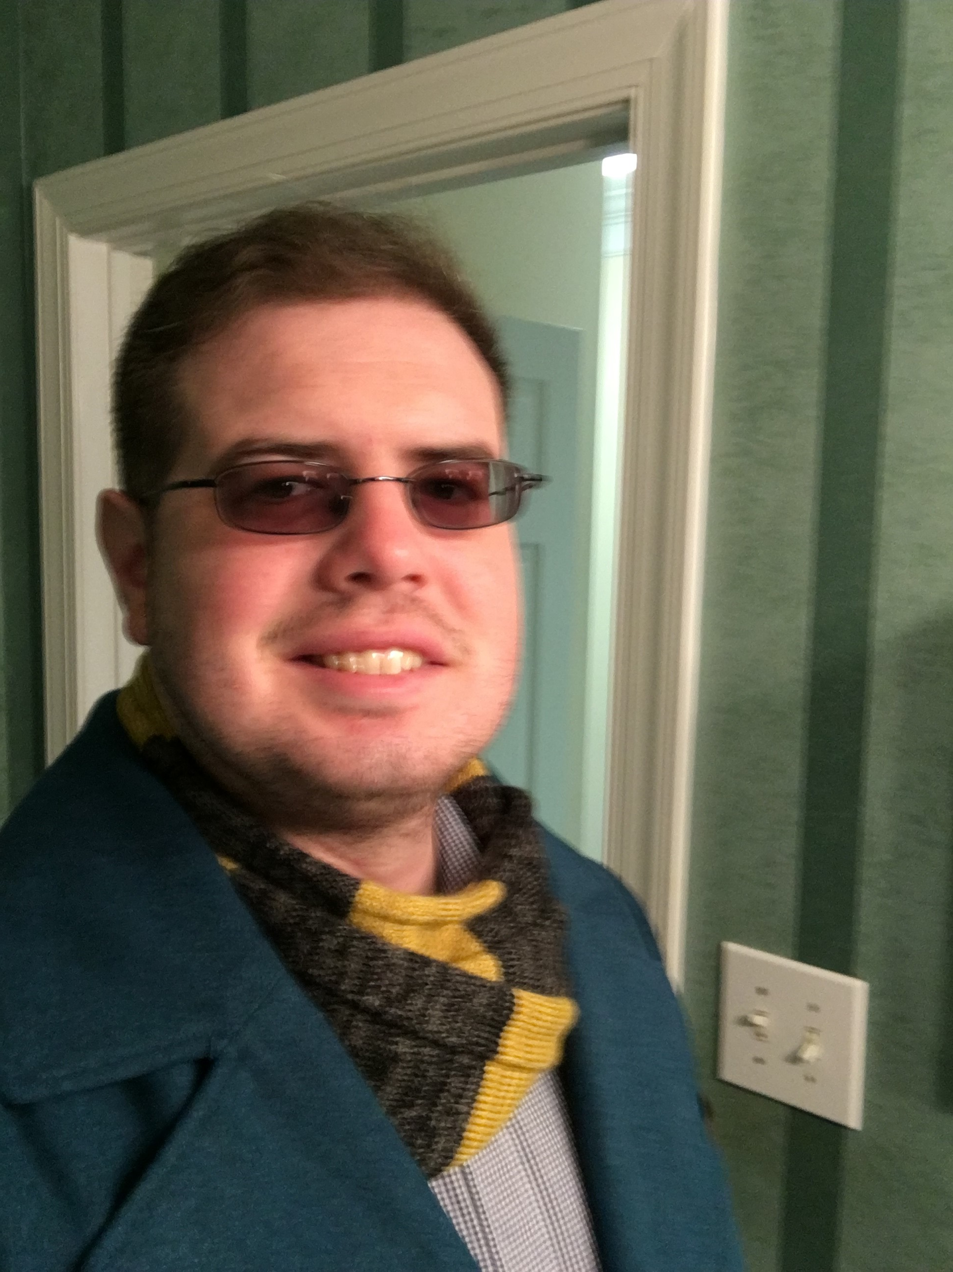

Mr. Holmes
7TH GRADE LIFE SCIENCE AND SOCIAL STUDIES TEACHER

Slide 2

MY CONTACT INFORMATION
Email: holmemi@boe.richmond.k12.ga.us
Life Science Remind Information:
    https://www.remind.com/join/74g4879
Social Studies Remind Information:
    https://www.remind.com/join/ch4987b
Class Webpage: Holmes, Michael / Welcome (rcboe.org)
School Number 706-737-7288

Slide 3
CHECKOUT MY WEBSITE TO VIEW THE FOLLOWING INFORMATION
Week At A Glance (WAG)
Class Syllabus/Supply List
Resources
Additional Information

Slide 4
DAILY SCHEDULE
9:20-9:50 am- Homeroom/Extended Learning Time
9:55-11:25 am- Connections/7th Grade Planning Period
11:30-12:55 pm- 7th Grade Social Studies and Lunch
12:55-2:15 pm- 7th Grade Life Science
2:15-3:10 pm- 7th Grade Life Science
3:10-4:05 pm- 7th Grade Life Science

Slide 5


Log into your Launchpad account
Access and review your schedule with class times in Infinite Campus
For questions and concerns, please email your teacher. Teacher emails can be found on the teacher’s class page and also on slide #2 in this PowerPoint.
First Day of
School
Expectations
Watch the video link on Logging into Canvas as a student.
https://rcboe.instructuremedia.com/embed/048204ea-777e-4c04-9fc0-357111372c96

Slide 6
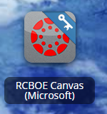
RCSS LEARNING PLATFORM AND CANVAS
New to the Richmond County
Go to rcboe.org
Click Student
Click Launch Pad
Watch logging into Canvas as a student.
https://rcboe.instructuremedia.com/embed/048204ea-777e-4c04-9fc0-357111372c96
Your child will login through Launch Pad to access RCBOE Canvas.
Click link to watch Tutorial Video
https://www.rcboe.org/Domain/16265

Slide 7
ARRIVAL AND DISMISSAL
Morning Arrival Afternoon Dismissal
  Drop your child off on Dragons Way Bus riders report to Bus Loading Zone
  behind the school.
  Morning Drop off time for car riders: Walkers dismissed from Bus Loading Zone where
  8:30 AM the crossing guard is located.
  Early Drop off students are unsupervised. Car Rider pick up time: 4:00 PM
  Please remain with your child until 8:30 AM, when
  teachers report for duty.

Slide 8
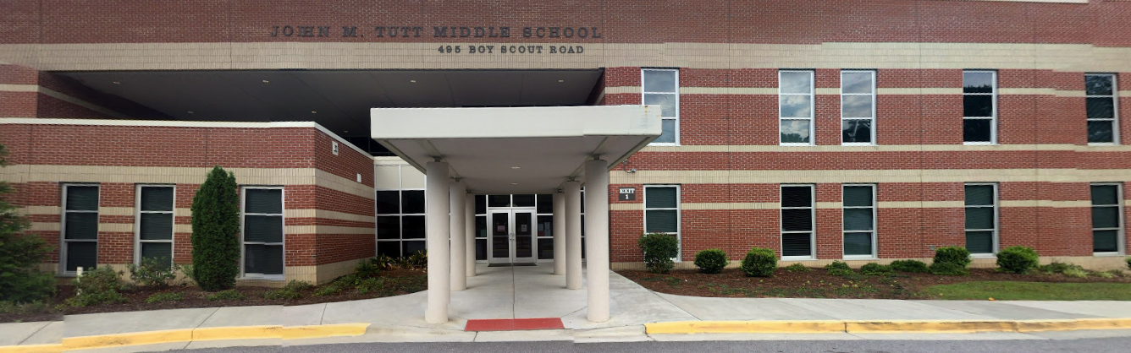
THANK YOU FOR VISITING JOHN M. TUTT MIDDLE SCHOOL

